Slide 1



Using ISC Data to Build a Prior of Seismicity for NET-VISA
Nimar Arora
Dmitry Storchak
Stuart Russell
Notes:
As you may have heard in Dr. Lassina Zerbo’s opening remarks NET-VISA is a Bayesian Approach for network processing that came out of the early SnT conferences. It has been heavily supported by the CTBTO.
In this work we describe the ongoing extension of our model in collaboration with our colleagues in ISC Dr. Dmitry Storchak.

Slide 2
Overview
Bayesian Approach
Depth Model
Learning a Depth Model from ISC Data
Results
Results on Explosions
Deployment Progress
Notes:
I will first give an overview of our Bayesian approach before delving into the new depth model that we have added in collaboration with ISC.
Next I will describe some of our results specially on explosions, which is of course the ultimate objective of the CTBTO.
And finally, I will talk a little bit about our current status

Slide 3
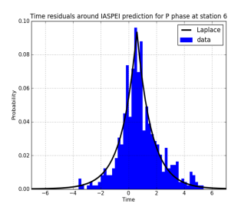
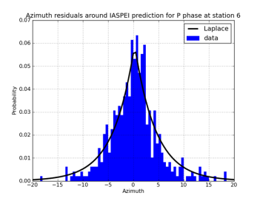
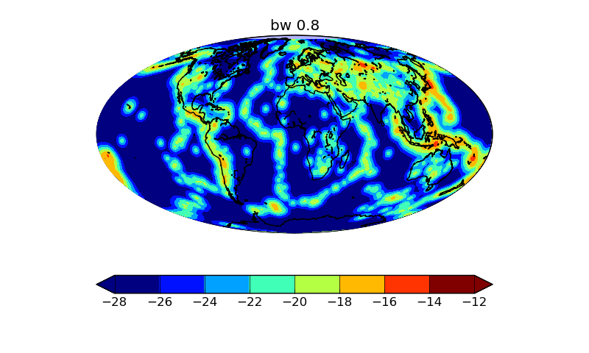
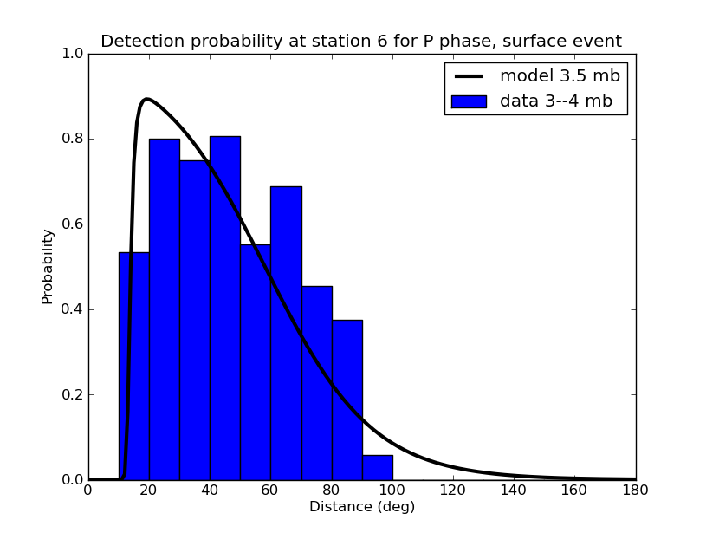
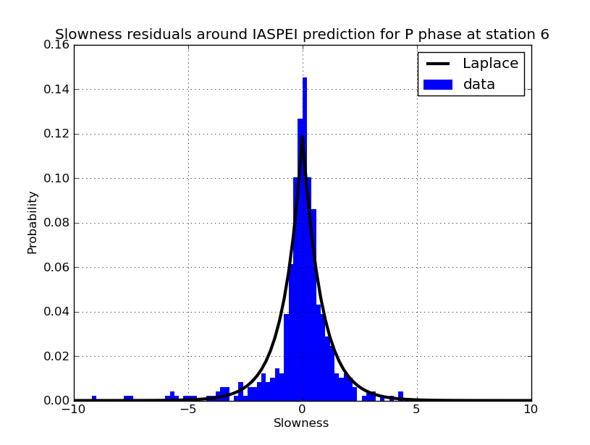
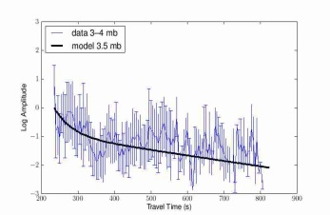
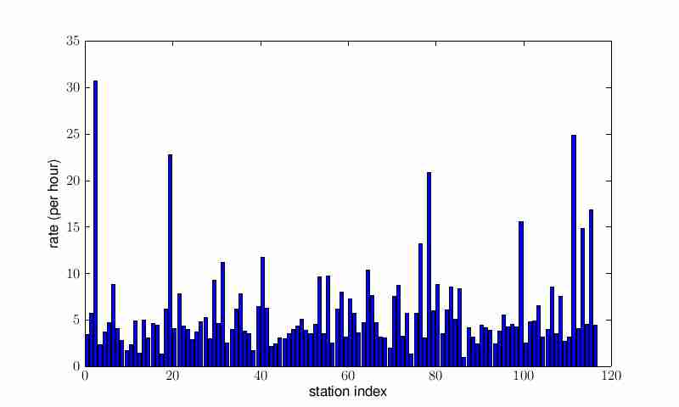
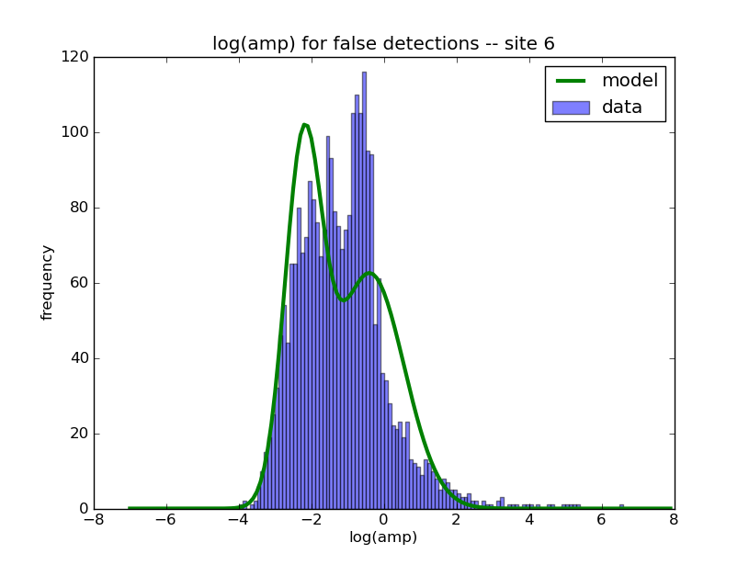
Bayesian Approach
Real
Noise
Prior
Likelihood
Notes:
The Bayesian approach can be summarized very easily by describing the prior and the likelihood. Thee is a prior distribution of event locations. Event may or may not be detected. And if detected they produce certain attributes. At the same time stations can produce noise which can have its own attributes. Once we have this model, inference is simply a matter of finding an event bulletin with the highest probability. Event definition criteria is very simple: An event is built if the event hypothesis has higher probability than the noise hypothesis.

Slide 4
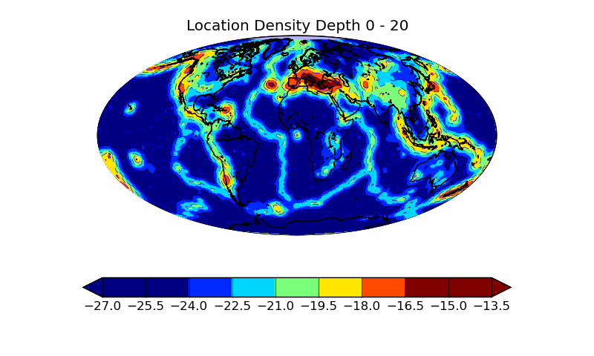
Depth 0 – 20 km
Notes:
ISC data for known earthquakes

Slide 5
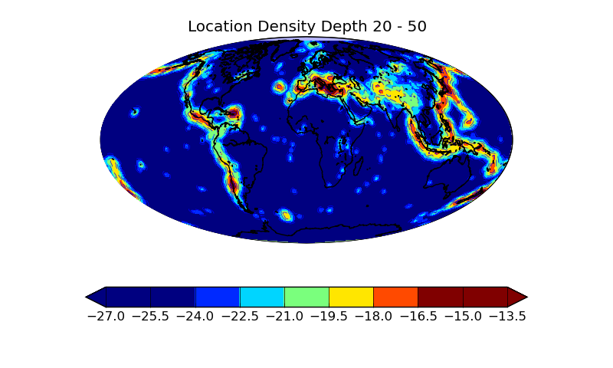
Depth 20 - 50

Slide 6
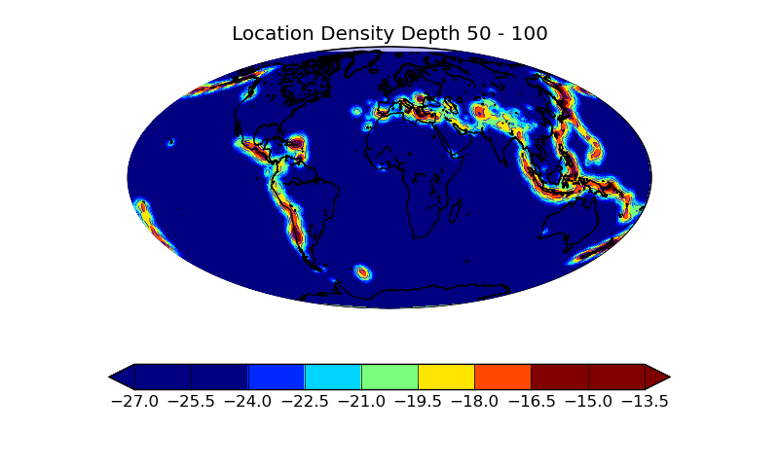
Depth 50 - 100

Slide 7
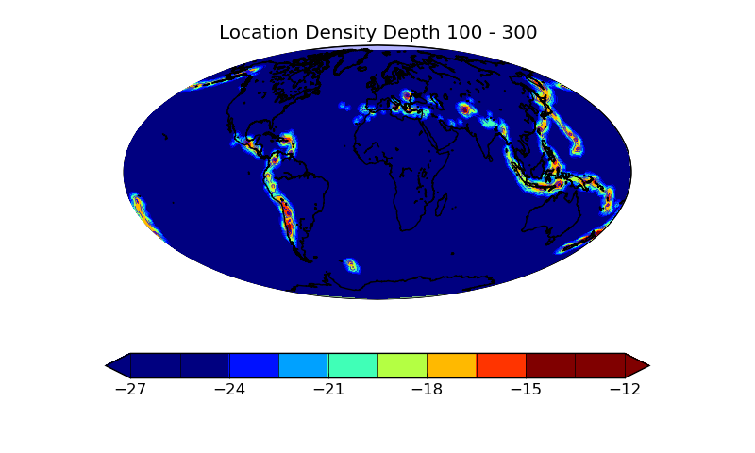
Depth 100 - 300

Slide 8
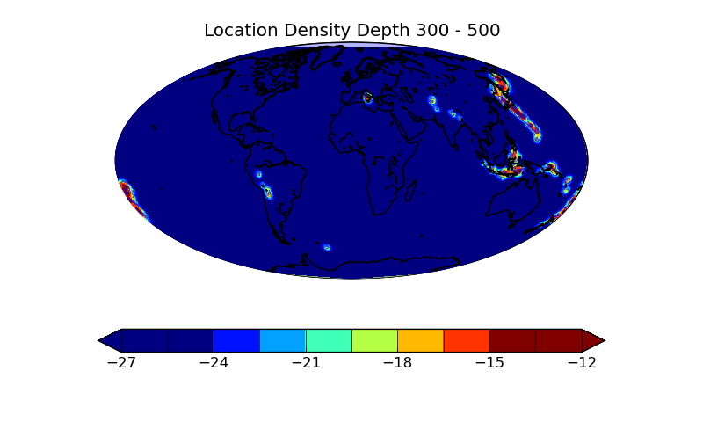
Depth 300 - 500

Slide 9
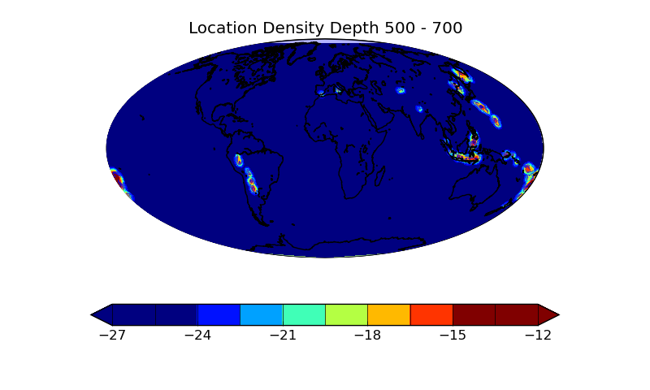
Depth 500 - 700

Slide 10
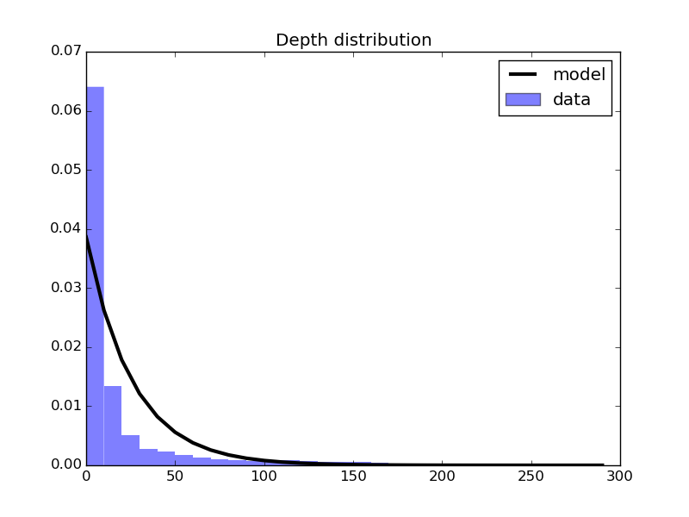
Probability of an event occurring at a given depth

Slide 11
Kernel bandwidth selection using leave-one-out cross-validation

Slide 12
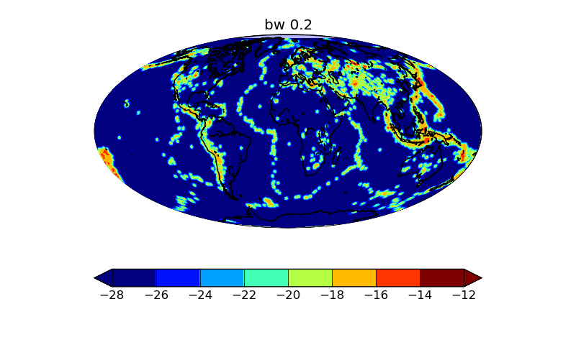
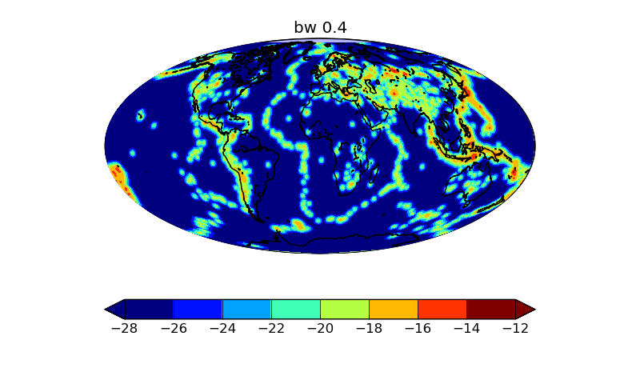
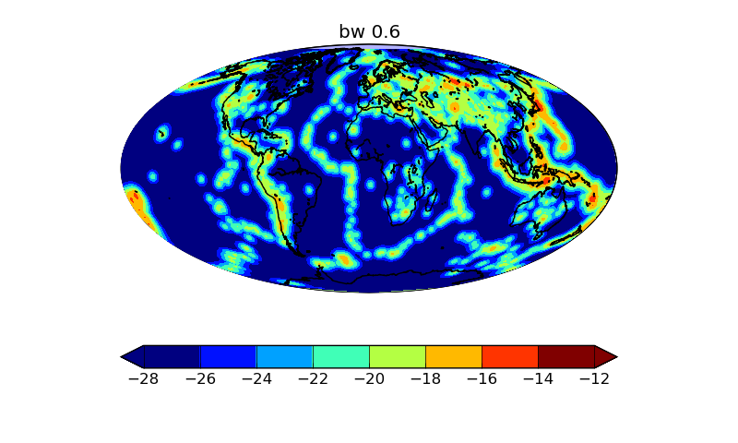

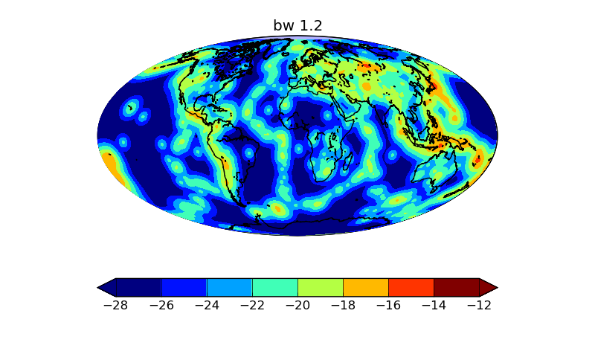


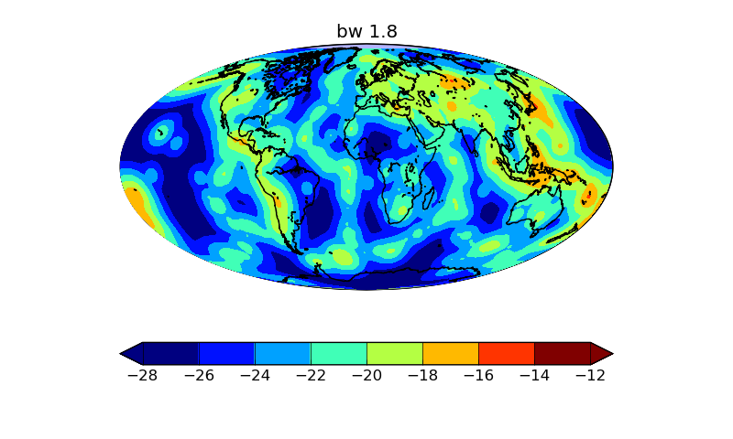
Notes:
At each depth we need a probability density which is based on something called a kernel density estimate. And a key parameter that goes into a kernel density function is the bandwidth of the kernel. Or in layman’s terms the spread of each data point.
In this picture, which was built using 10 days of CTBT events, we can see the effect of building a kernel density estimate using increasing bandwidths.
At small bandwidths we get a very sharp estimate, but it misses important seismic contours specially around the spreading ridges.
But if there is a very large bandwidth then the probability is almost like a uniform distribution.
We need something in between – we learn this using leave-one-out cross-validation.

Slide 13
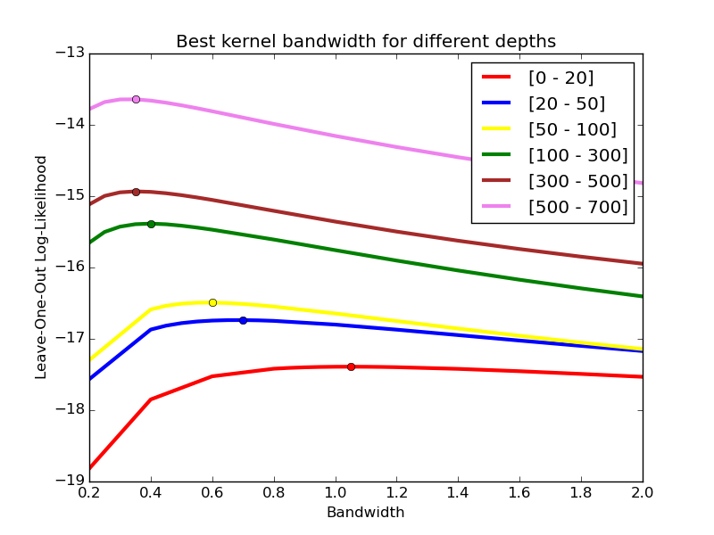
Notes:
For each depth layer, we repeat the cross-validation process to obtain the optimal bandwidth at that depth.
…
As we go deeper into the earth’s crust the optimal bandwidth decreases which says that at great depths events don’t have much novelty. Note: there are still clusters and widely spread out clusters but these clusters have sharp boundaries whereas on the surface the clusters of events have diffuse boundaries.

Slide 14
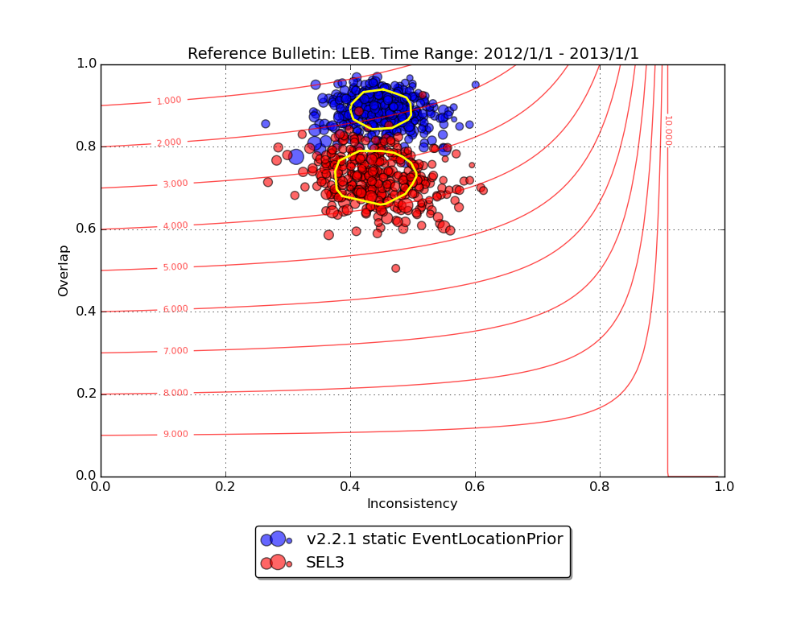

Slide 15
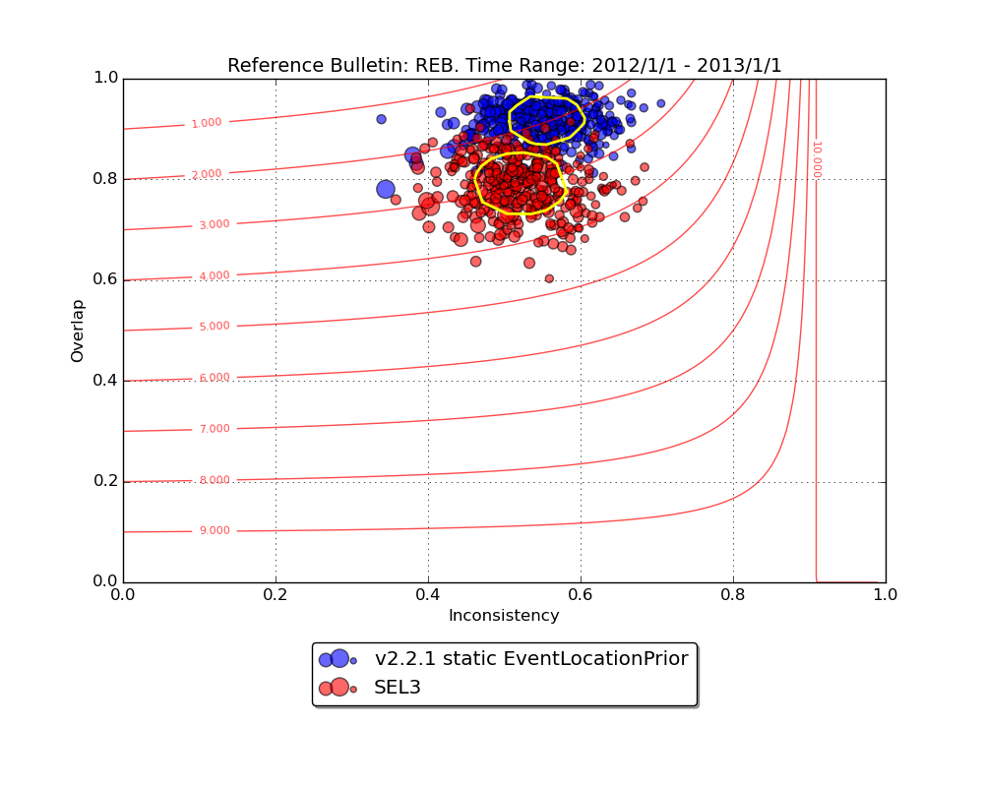

Slide 16
So what about explosions?

Slide 17
ISC Man-made events – 2012
Azimuth Gap

Slide 18
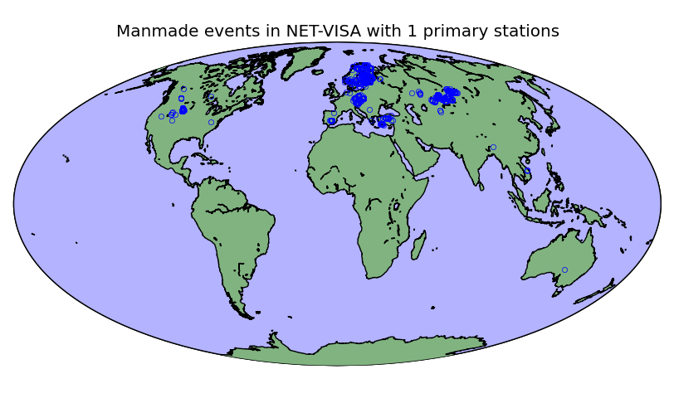
Detection of Man-made Events

Slide 19
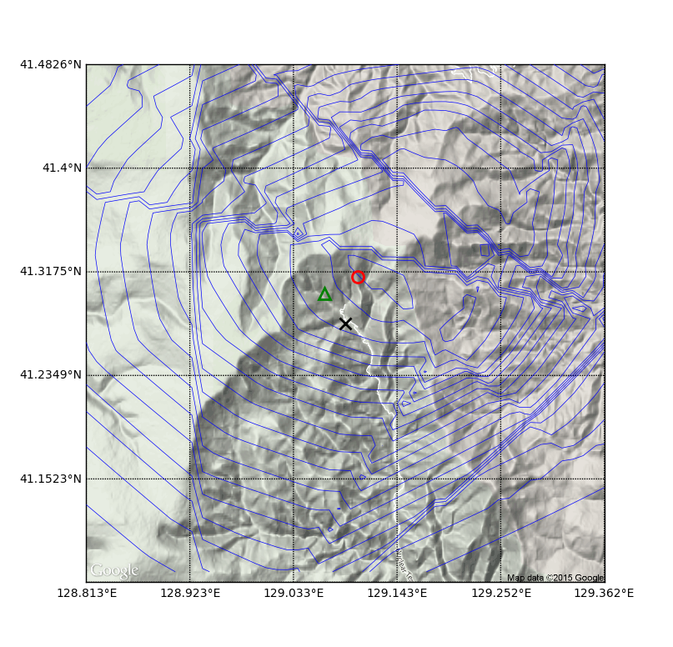
10 minutes after DPRK 3
Final SEL3
Final LEB
Tunnel
Entrance

Slide 20
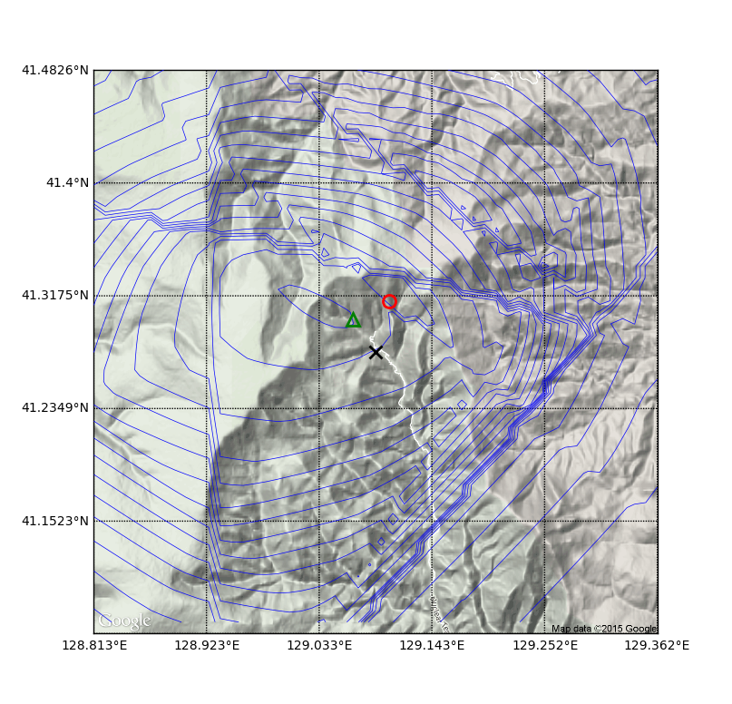
30 minutes after DPRK3

Slide 21
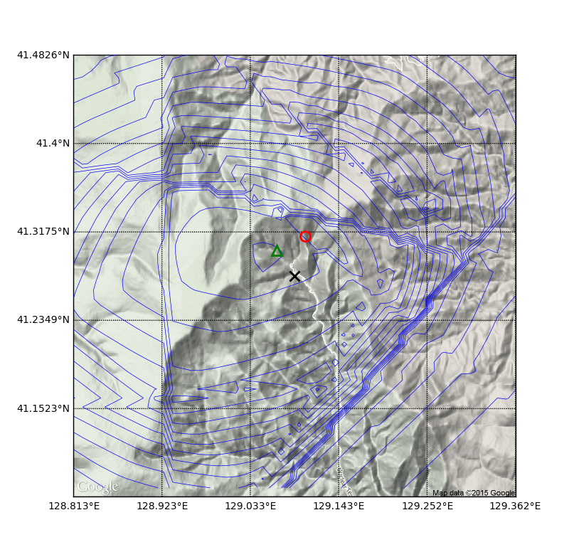
1 hour after DPRK3

Slide 22
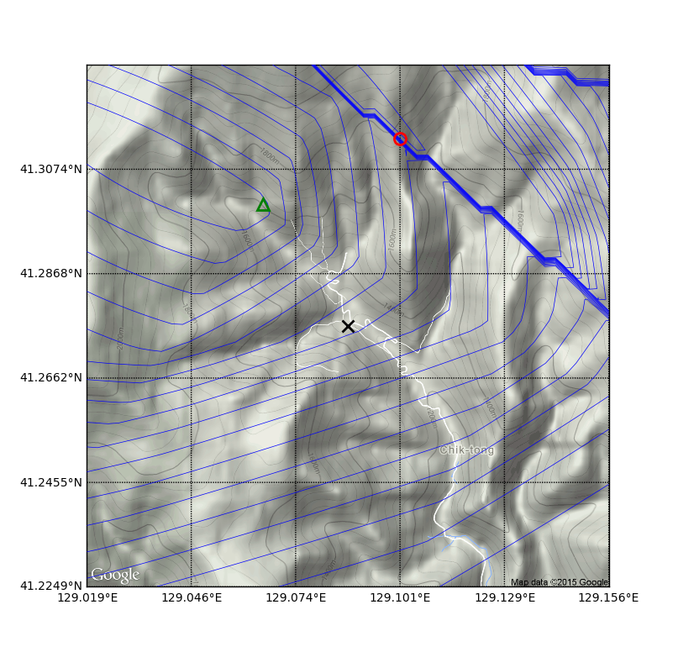
30 minutes after DPRK3

Slide 23
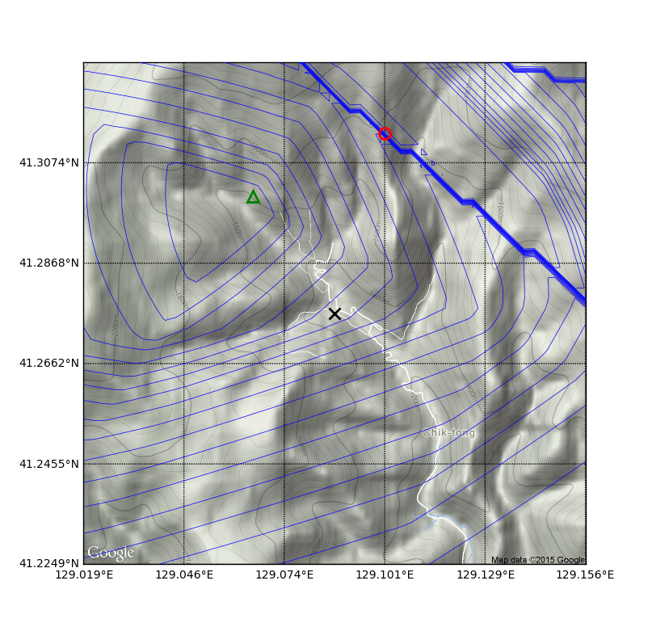
1 hour after DPRK3
Notes:
Note: this is using automatic arrivals

Slide 24
When is NET-VISA going to be deployed at IDC?
Full Pipeline testing (presented at WEG 2015 by Ronan Le Bras)
Website to show NET-VISA bulletin to the analysts (Noriyuki Kushida)
Planned: Short-term tool to help analysts save time building events that are missing in GA
Notes:
Answer: I honestly don’t know. I can say though that a lot of progress is being made

